Slide 1
WOW 2-1
*READ: Oliver Goldsmith said, “People seldom improve when they have no other model but themselves to copy.”
*THINK: What do you think Goldsmith means? Do you agree with him or not?
*WRITE: Write about the importance of having a role model. Who is a role model you have? Why? According to Goldsmith, what would happen if we didn’t have someone as our role model?

Slide 2
WOW 2-2
READ: “The writing process, the way I go about it is I do whatever the beat feels like, whatever the beat is telling me to do. Usually when the beat comes on, I think of a hook or the subject I want to rap about almost instantly. Within four, eight bars of it playing I'm just like, 'Oh, OK. This is what I wanna do.’” - Eminem.
THINK: Just like a rapper, you have your own way of writing. What process do you go through when writing a paper? How would you explain your process to someone?
WRITE: Explain your writing process.
(First, draw a graphic organizer)

Slide 3
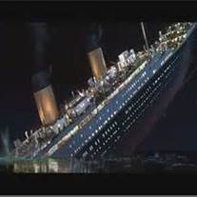
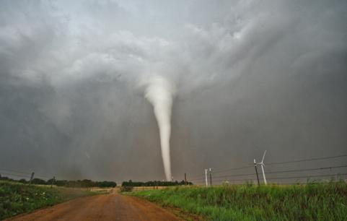
WOW 2-3
Think: “Sometimes, no matter how much and how carefully you prepare, the disaster is just too big," said Zhang Qiang, an expert on disaster mitigation at Beijing Normal University's Institute for Social Development and Public Policy. What does he mean? Write: Explain how you would react before, during, and after a disaster.
First, draw a graphic organizer.

Slide 4
WOW 2-4
READ “His jaw tightened and his leathery face took on a hard, whittled look. ‘You’re too young to know what you want,” he said, and the discussion was over.’” (Hale 7)
THINK: Seth in Dark Water Rising has a conflict with his dad about his future. What are things you want but your parents/adults in your life have different opinions than yours?
WRITE: What are your plans for your future?

